Slide 1
Pharmacy
عبدالرحمن عبدالناصر محمد عطيفي
عبدالرحمن رضا محمد احمد
عبدالله ناصر فتحي محمد
عبدالرحمن خالد لطفي محفوظ
زياد علي محمد علي

Slide 2
Introduction
For every disease there is a medicine, so the source of the medicine should be easier and more organized
The pharmacist plays a major role in providing health care
Therefore, we have made a complete system that contains exports and imports, all the names and types of medicines, and classifies them according to some diseases. It also contains transactions with customers and workers in the place and saves all the data entered for reference at any time.
The system has an easy-to-use interface for all the previously mentioned points

Slide 3
Project benefits
Ease of business dealing with pharmacy exports and imports
Ease of dealing with customers and recording their data and transactions with the pharmacy
Ease of access to the places of medicine and knowing all the information about it in terms of price, location and category
Registration of pharmacy employees' data
Supplier data registration

Slide 4


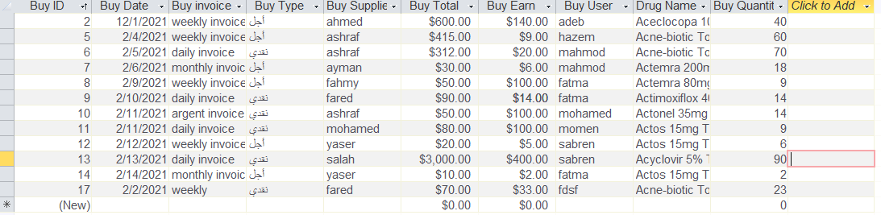
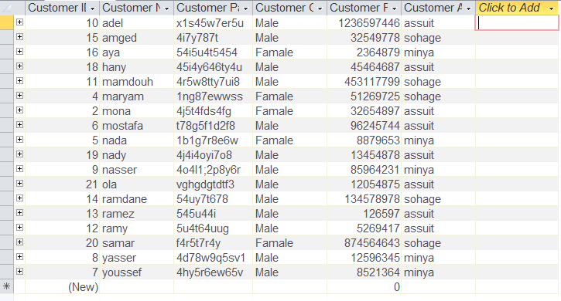
Details about project
Tables
1-buy 2-customer

Slide 5
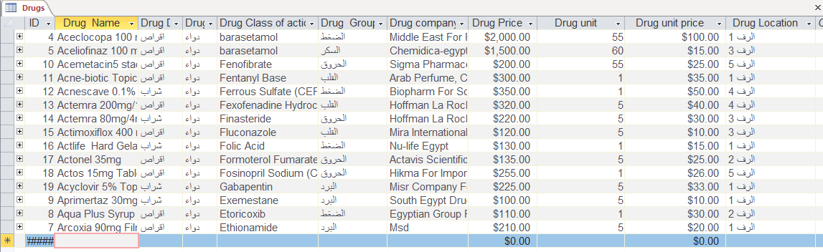
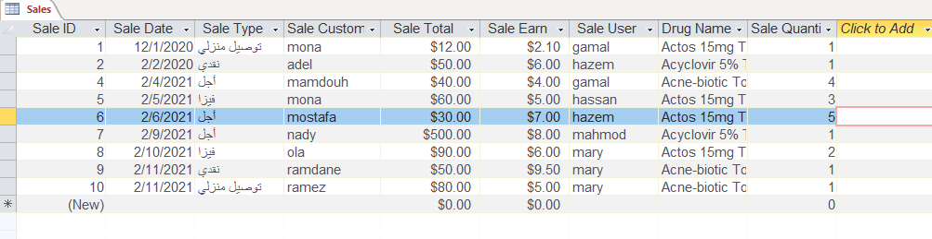
3- Drugs
4- Sales

Slide 6
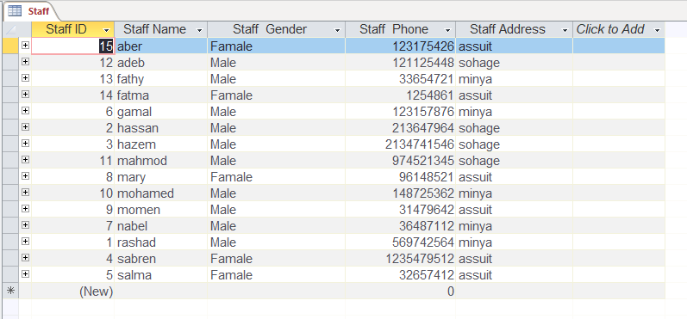
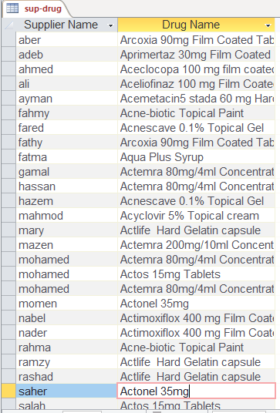
5-staff 6-drug suppliers

Slide 7
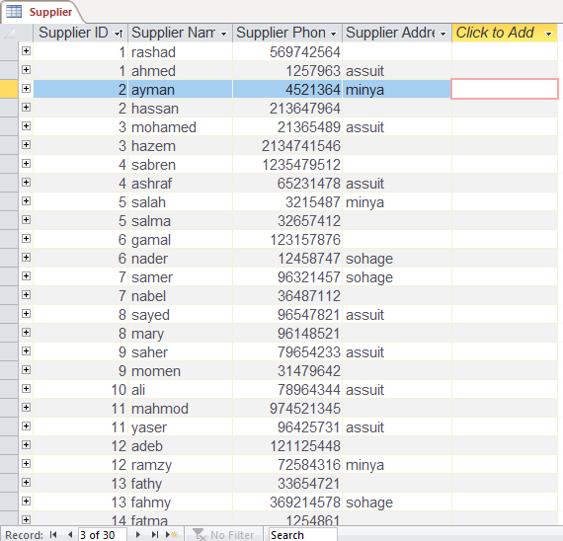
7- Suppliers

Slide 8
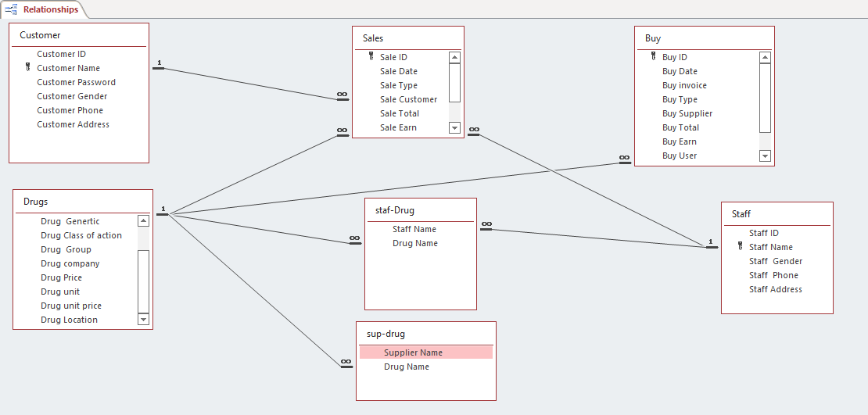
ERD

Slide 9
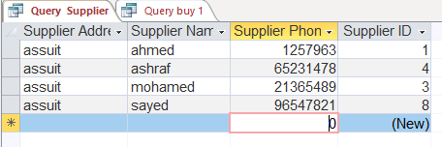
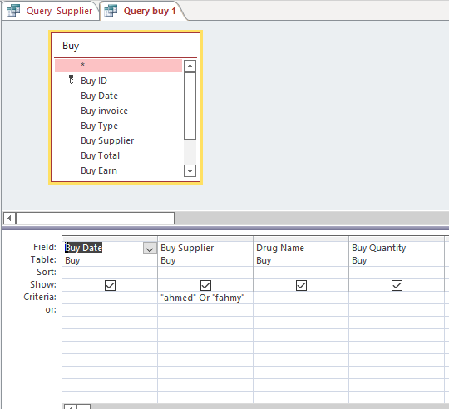
Queries
There are a lot of queries in the database to make it easier to control the stored data from updating, clearing, searching for it or using it to extract various reports.
There are 3 queries for buy:
1- this query shows buy date ,buy supplier , drug name and buy quantity for “Ahmed” or “fahmy”.

Slide 10
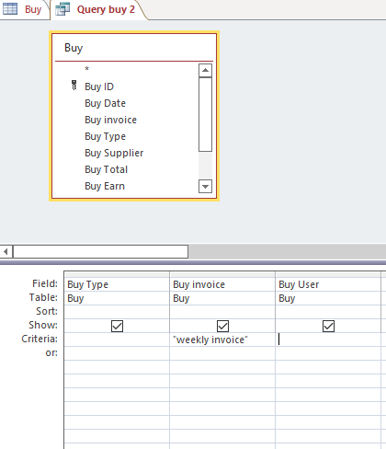
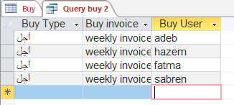
2-it shows buy user ,buy invoice and buy type using weekly invoice.

Slide 11
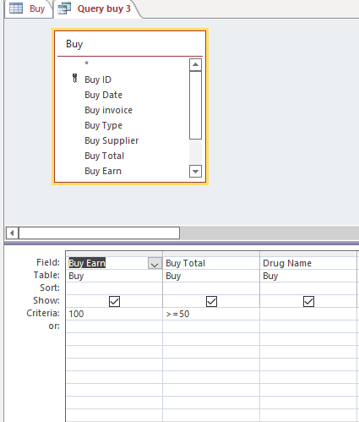
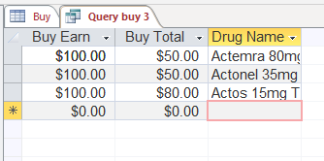
3- it shows but earn ,but total and drug name using buy earn >100 and but total <=50.

Slide 12
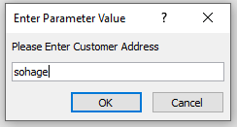
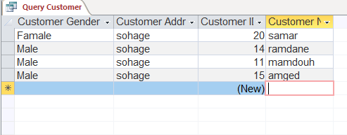
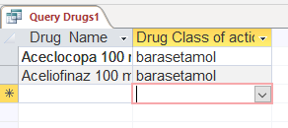
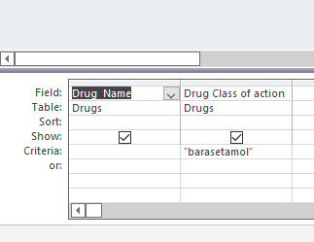
There are one query for customers
It shows customer gender ,customer address , customer id , customer name using Address..
There are two queries for drugs
1- shows drug name and drug class
Using critria “barasetamol”

Slide 13
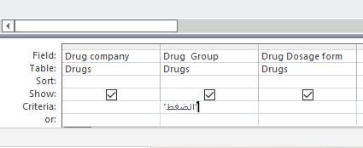
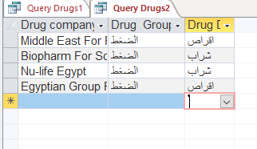
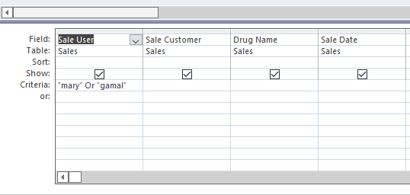
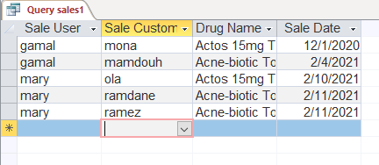
2- shows drug company , drug group and drug dosage form using criteria “الضغط” .
We make three queries for sales.
1- shows sale user , sale customer , drug name and sale date using criteria “mary” and “gamal”.

Slide 14
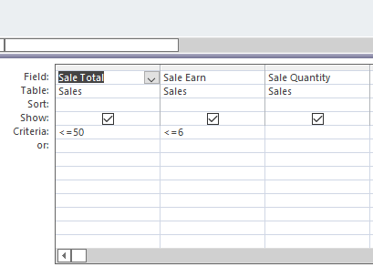
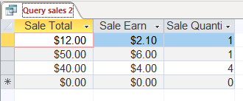
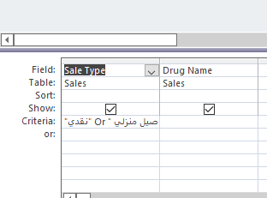
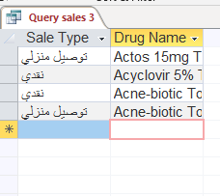
2- show sale total , sale earn sale quantity using criteria sale total <=50 ,sale earn <=6.
3- show sale type and drug name using criteria “نقدي” or “توصيل منزلي”.

Slide 15
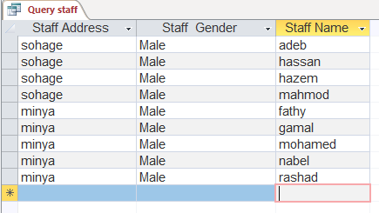
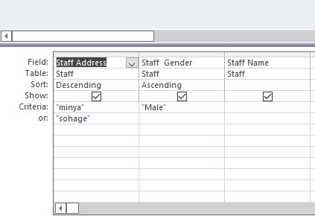
We make one staff query shows staff address , staff gender and staff name using criteria “minya” or “sohage” , “male”.

Slide 16
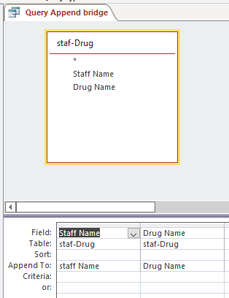
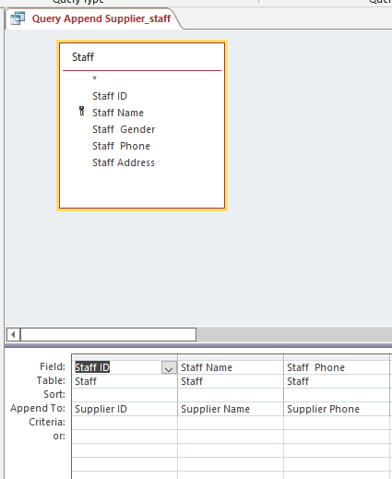
2 query append

Slide 17
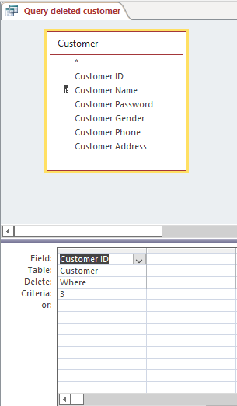
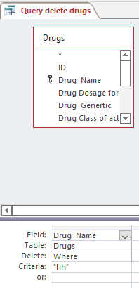
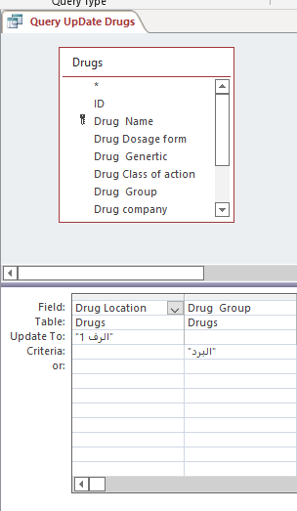
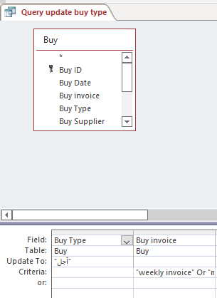
2 query delete 2 query update

Slide 18
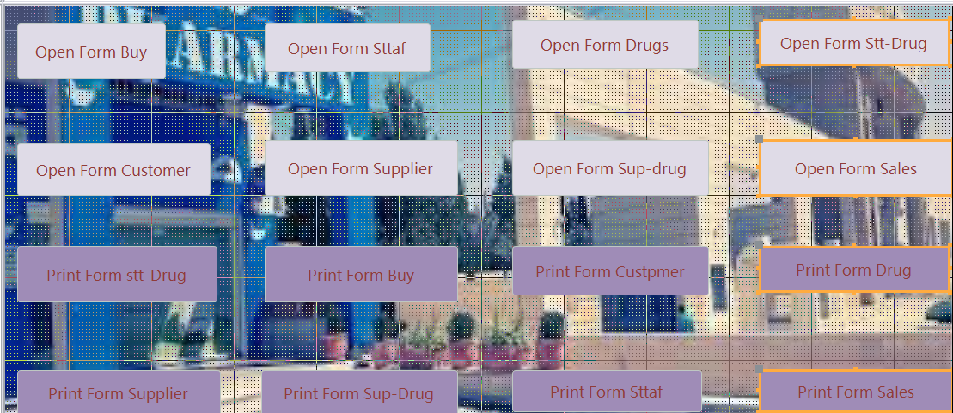
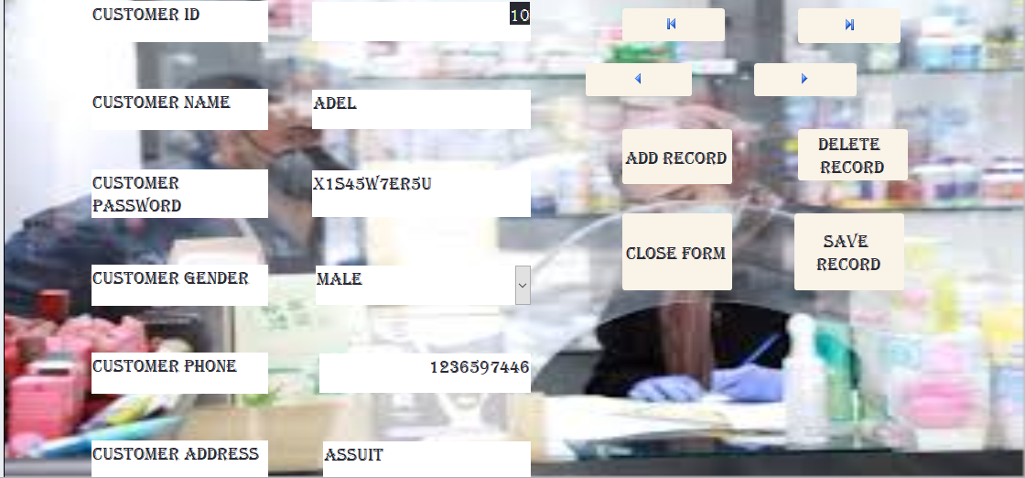
Forms
Main form
Customer

Slide 19
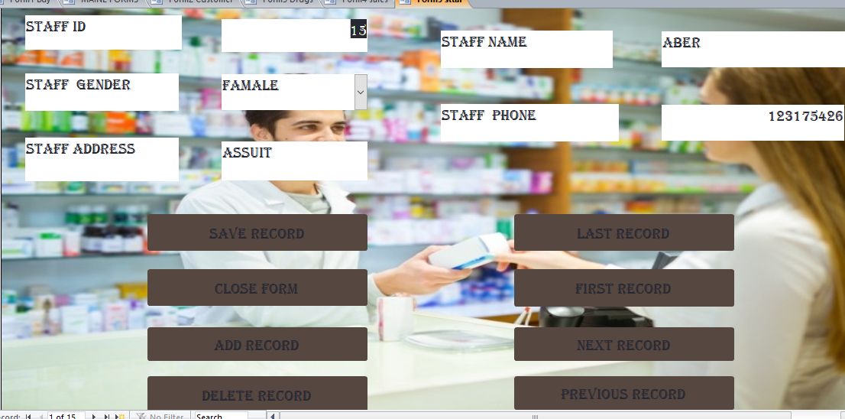
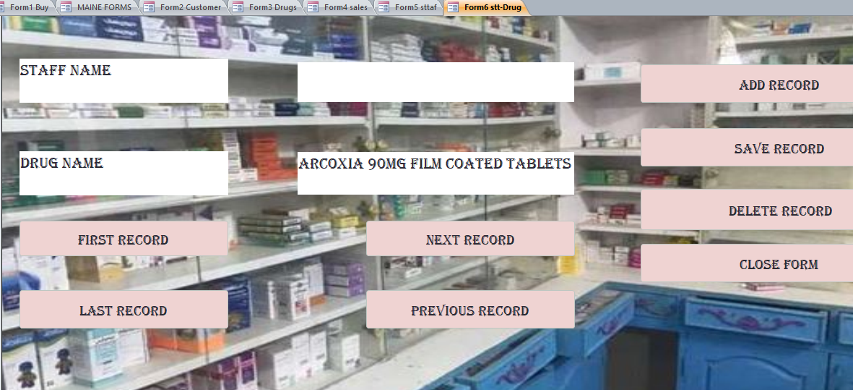
Staff
Staff drugs

Slide 20
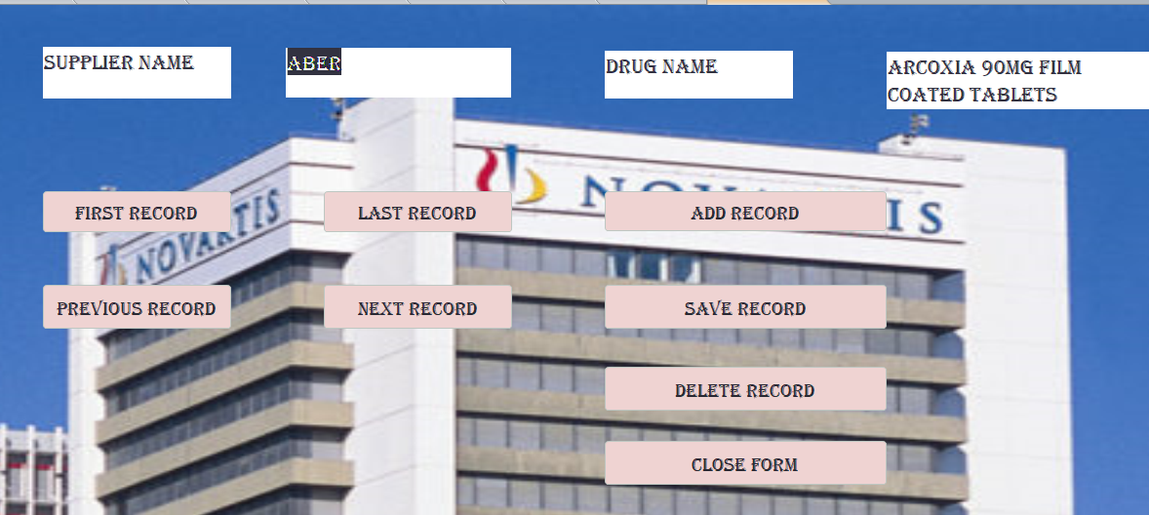
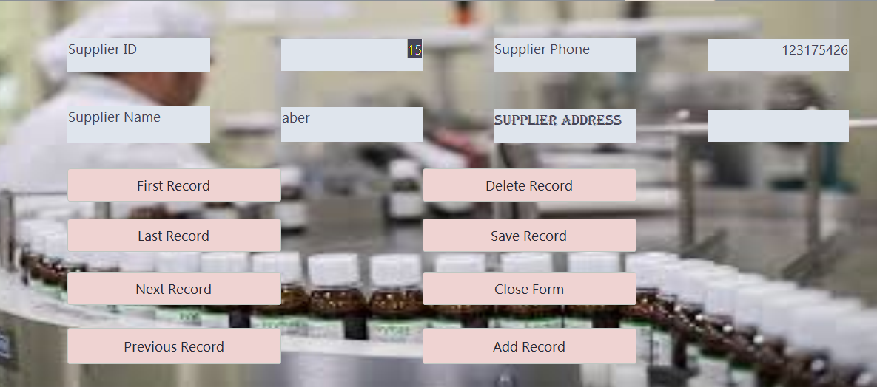
Supplier drugs
Supplier

Slide 21
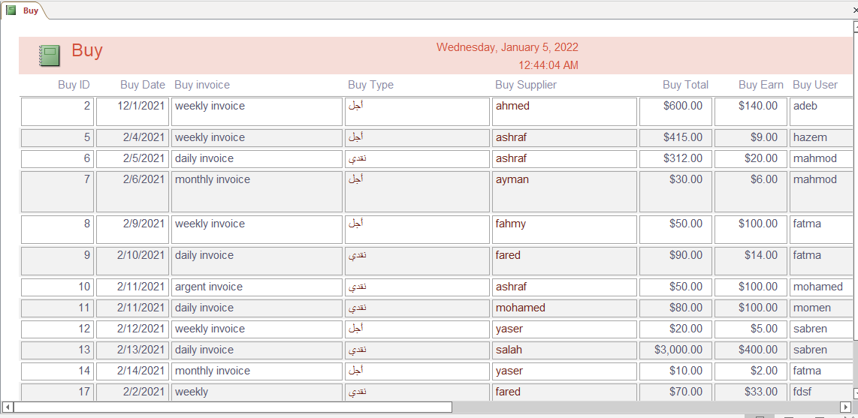
Reports
We make 9 reports
1-buy

Slide 22
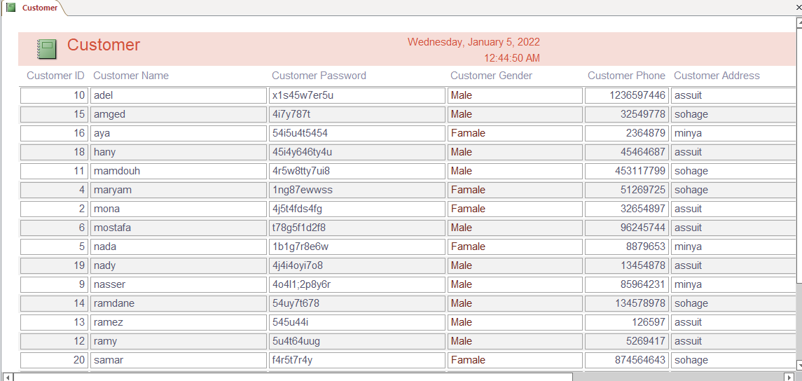
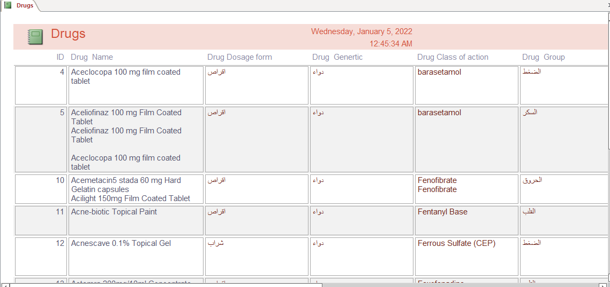
2- Customers
3-Drugs

Slide 23
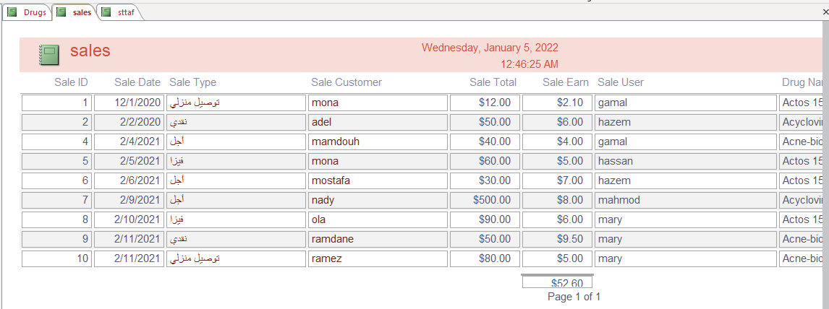
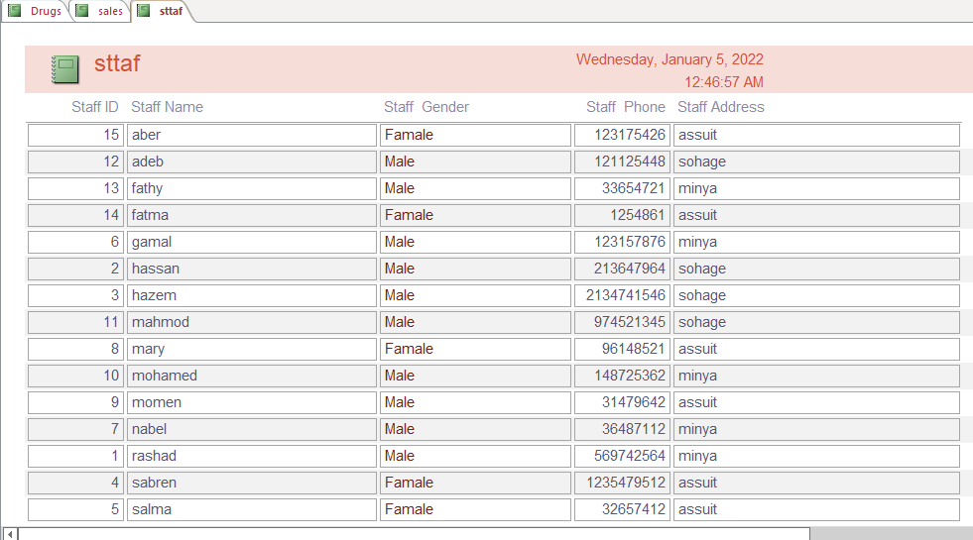
4- Sales
5- staff

Slide 24
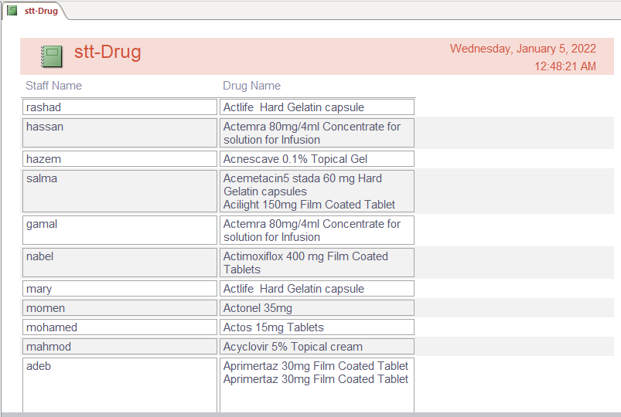
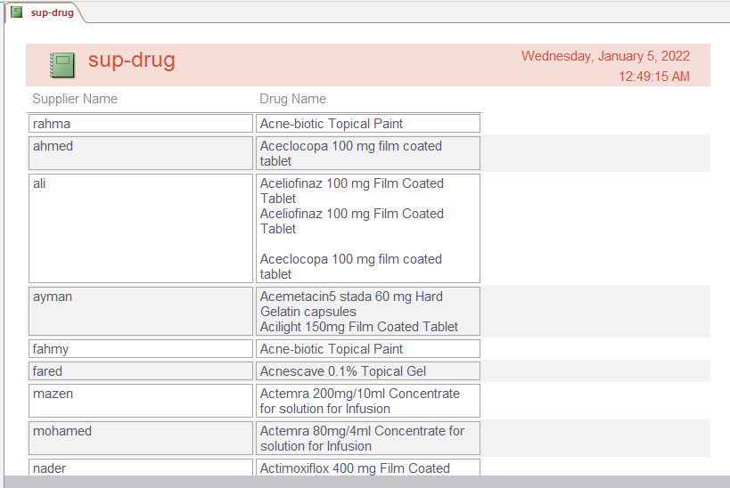
6-staff drug
7- supplier drugs

Slide 25
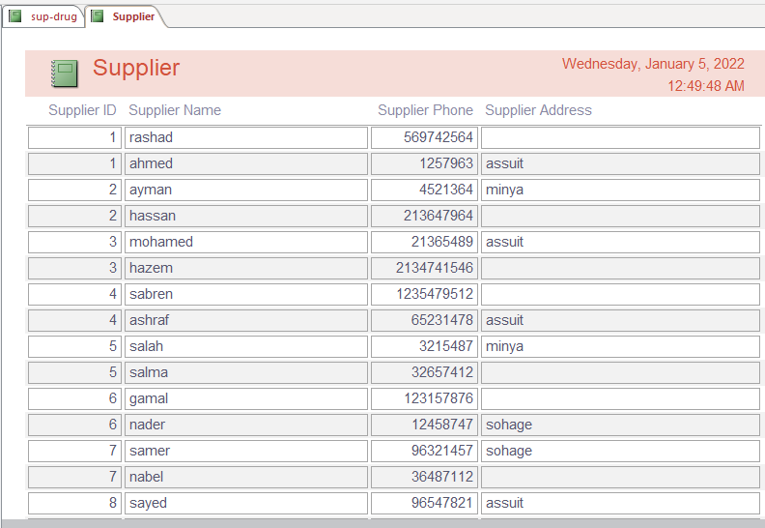
8-suppliers

Slide 26
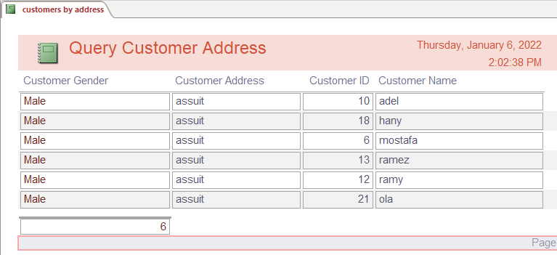
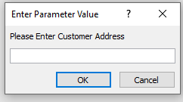
Customer by address

Slide 27
https://github.com/AbdelrahmanNasser00/is-project.git

